Slide 1
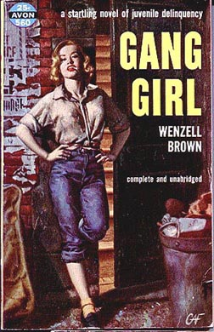
Criminology – Female Criminality
Before the intervention of Feminism, the
disciplines of Criminology and Sociology tended to view women as ‘invisible’ other than in the category of ‘mothers.’ An awful lot of Sociology simply didn’t talk about women at all.
Research concentrated on male experiences.
This research was then generalised to the whole population.
Areas like reproduction were ignored.

Slide 2
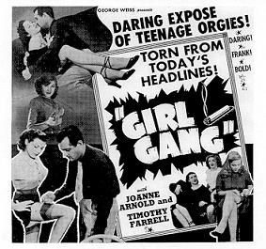
Female Criminality
For Heidensohn (’96), ‘Criminology…has almost nothing to say of interest or importance about women.’
‘The rise of modern Feminism brought about a reappraisal of women’s roles in society as a whole, and in relation to crime, women’s roles as deviants and victims.’
Deviance; a Refresher – for Becker (’63), ‘The deviant is one to whom that label has been successfully
applied; deviant behaviour is behaviour
that people so label.’
As Feminists began to raise issues
previously ignored by ‘malestream’
Sociology, so studies began to emerge of
the experiences of the ‘other half’ of the
population.

Slide 3
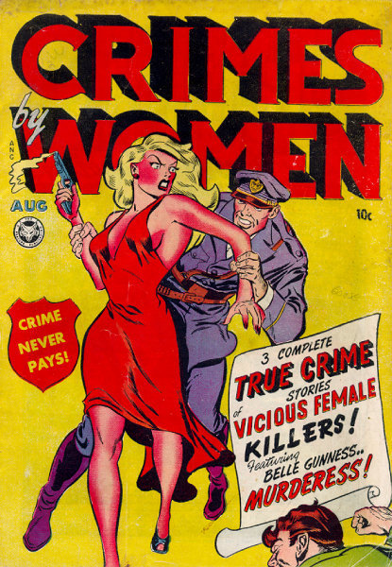
Female Criminality
However, early Criminologists had, if they ventured to consider female criminality and deviance at all, slipped into ‘common sense, ‘natural' explanations of such behaviour;
‘One of the most pervasive myths relating to female crime (is) that female delinquency is predominantly sexual delinquency.’ (Omodei, ’81)
For example, ‘Witch-hunting was the most public form of social control ever devised…’ (Larner, ’81)
‘For decades into the 20th century doctors
would continue to view menstruation,
pregnancy and menopause as physical
disease and intellectual liabilities.’
(Ehrenreich and English, ’79), and perhaps,
satisfactory explanations for female criminality.

Slide 4
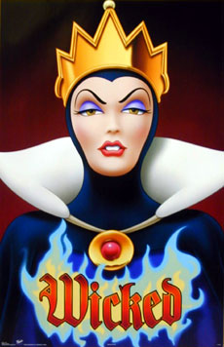
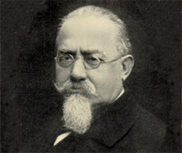
Female Criminality
Even when Criminologists did divert their gaze to women, they regressed into biological explanations for deviant behaviours;
‘Lombroso regarded prostitution as an equivalent to normal crime in men,’ (Heidensohn, ’96), ‘…a key symptom of the ‘unadjusted’ girl.’ (Thomas, ’23)
If only they would be nice girls – marry, settle down, give birth to and raise their children – then such behaviour would vanish!
For Lombroso and Ferrero (1895), ‘…the female criminal is a monster – her wickedness must have been enormous.’
In other words, such criminality reflects a failed biology, a sign for Lombroso of ‘evil.’

Slide 5
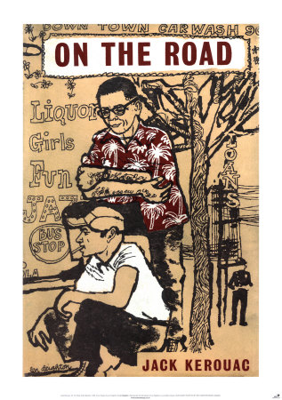
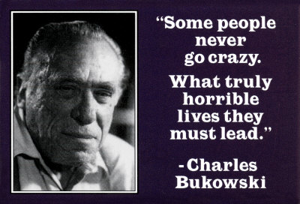
Female Criminality
The problem was that Criminology, as with all academic disciplines, was a male-dominated sphere. Men regarded the world through a very narrow lens, and the experiences of women rarely provoked serious interest.
‘Hitherto female crime has, for all practical purposes, been dealt with almost exclusively by men in their various capacities as legislators, judges, policemen…this could not fail to create a one-sided picture.’ (Mannheim, ’65).
For instance, there is a long literary heritage of the ‘poet outlaw,’ the ‘gun-slinging novelist’ or bluesman. Where are the female equivalents? Such behaviour appears to be the province of male artists alone.

Slide 6
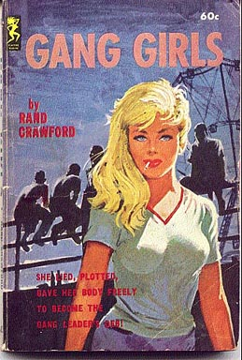
Female Criminality
And finally…
‘Labelling’ theory, derived from Social Action sociology, did perceive that ‘it is true in many respects that men make the rules for women in society.’ (Becker, The Outsiders, ’63)
However for Leonard (’82), though ‘…labelling might have begun a thorough analysis of women and crime…once again this analysis was not forthcoming.’
For Cohen (’80), ‘The absence of girls from the whole of the literature in this area is quite striking, and demands explanation.’
In studying subcultures of gang membership, women again were all but ignored.

Slide 7
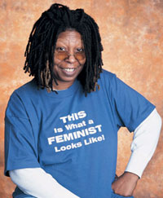
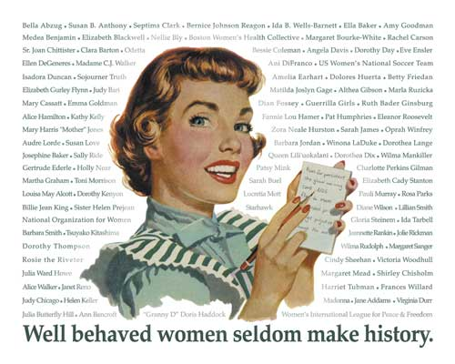
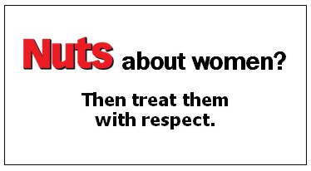
Female Criminality
So, it required Feminist Criminologists to enter the fray before academic literature on the subject began to appear.
Previously, female criminality had been dismissed as the province of ‘fallen’ women.
Thankfully, such research is now widely available, offering students of the discipline the opportunity to explore previously uncharted waters.
Woman have successfully insisted on being taken seriously as a suitable subject for enquiry!

Slide 8
This powerpoint was kindly donated to www.worldofteaching.com
http://www.worldofteaching.com is home to over a thousand powerpoints submitted by teachers. This is a completely free site and requires no registration. Please visit and I hope it will help in your teaching.

